Slide 1
Exploring Human Activity Recognition

Slide 2




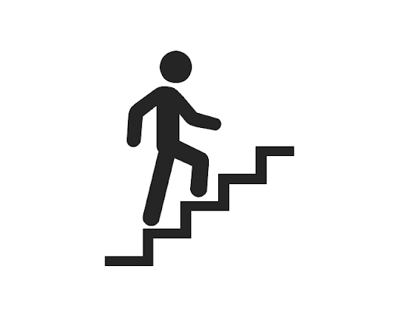

Examples of Human Activities?
Standing
Walking
Jogging
Sitting
Upstairs
Downstairs

Slide 3
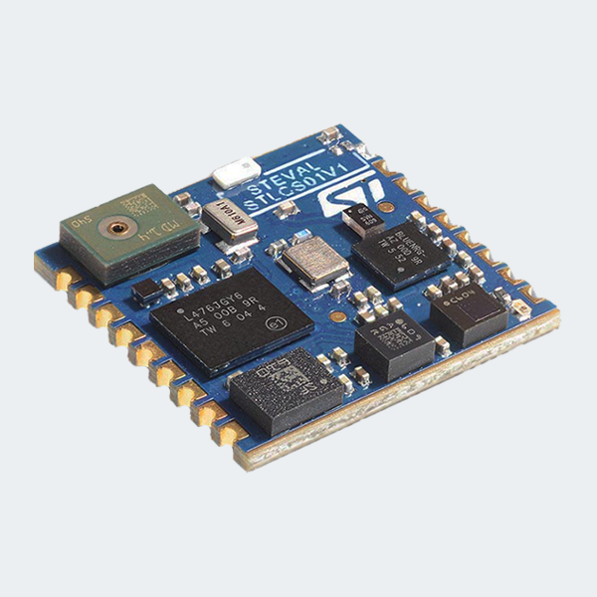

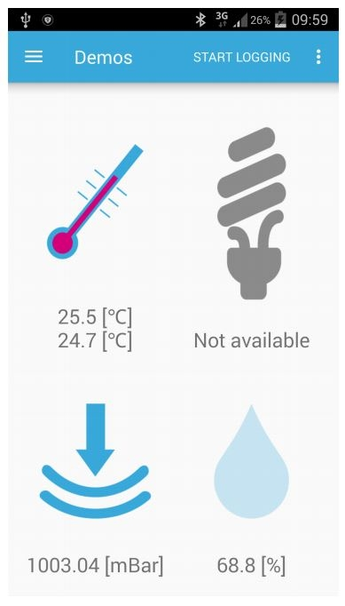


How did we capture human activities ?
Walking
Jogging
Standing
Sitting
Upstairs
Downstairs
Notes:
Add BLE App

Slide 4
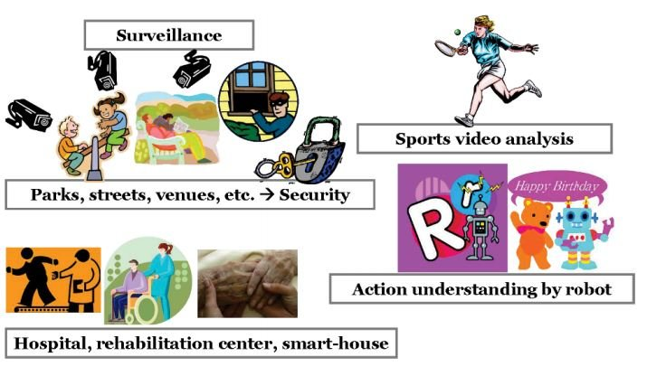
Where can we apply?

Slide 5
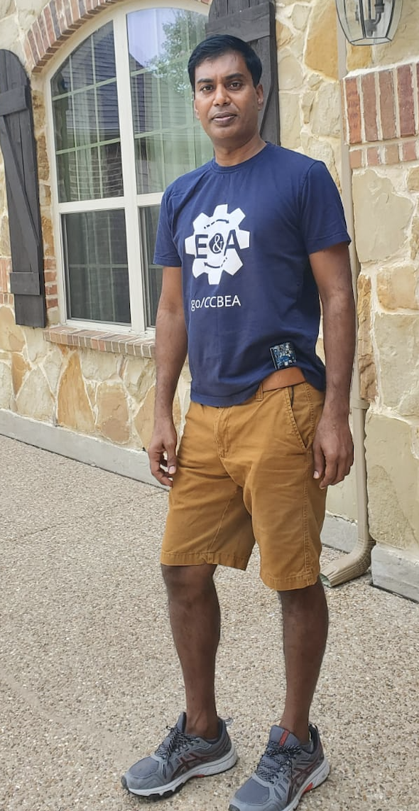
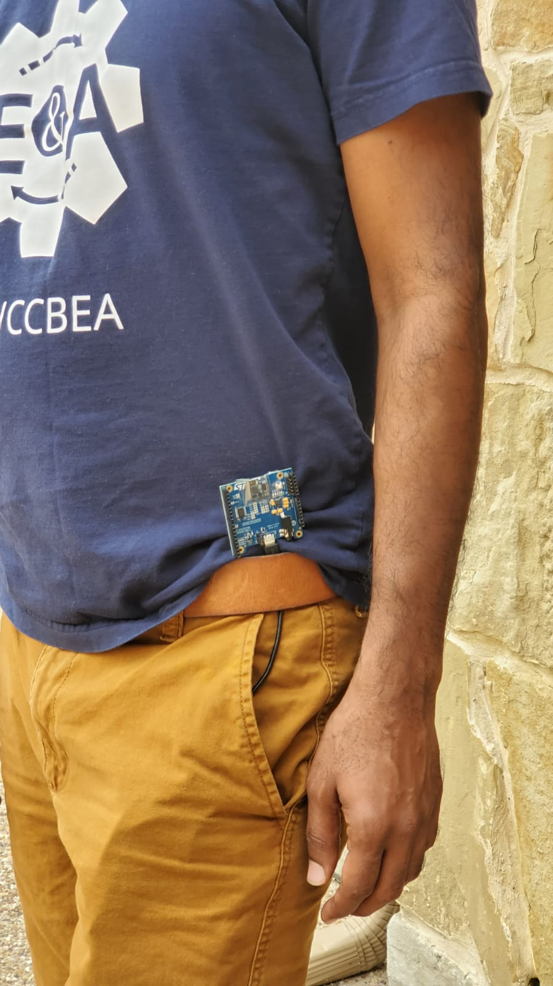
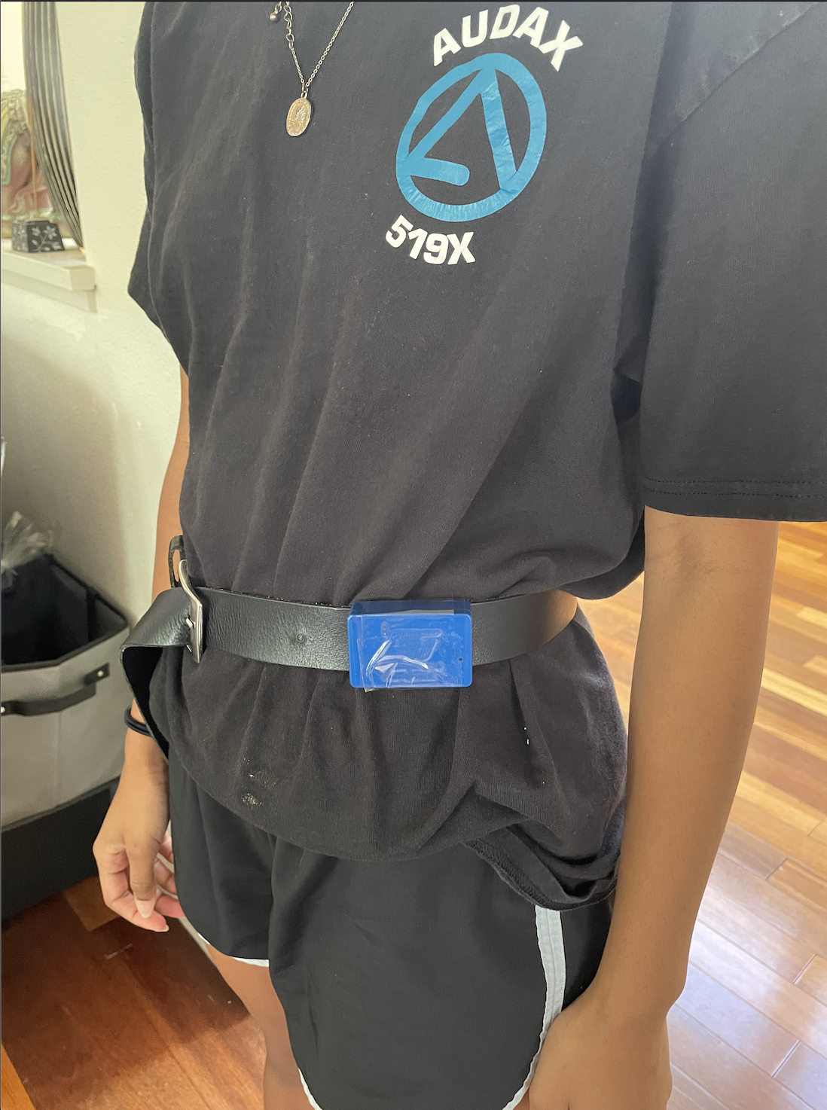
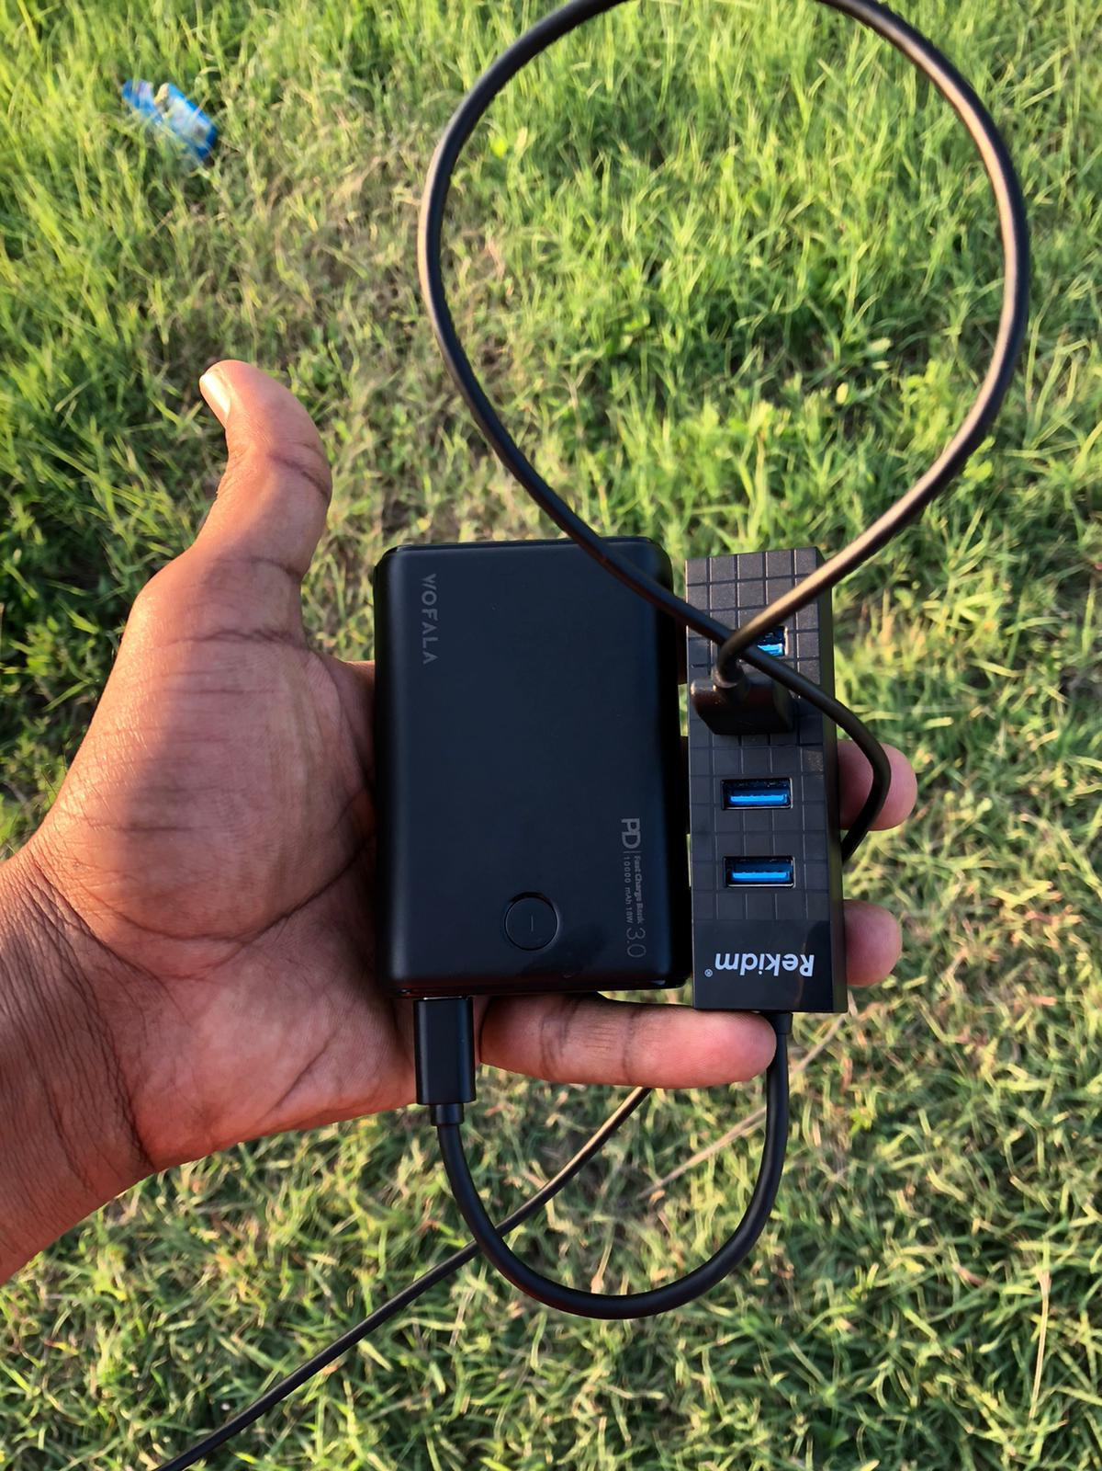
Sensor Placement on the body

Slide 6
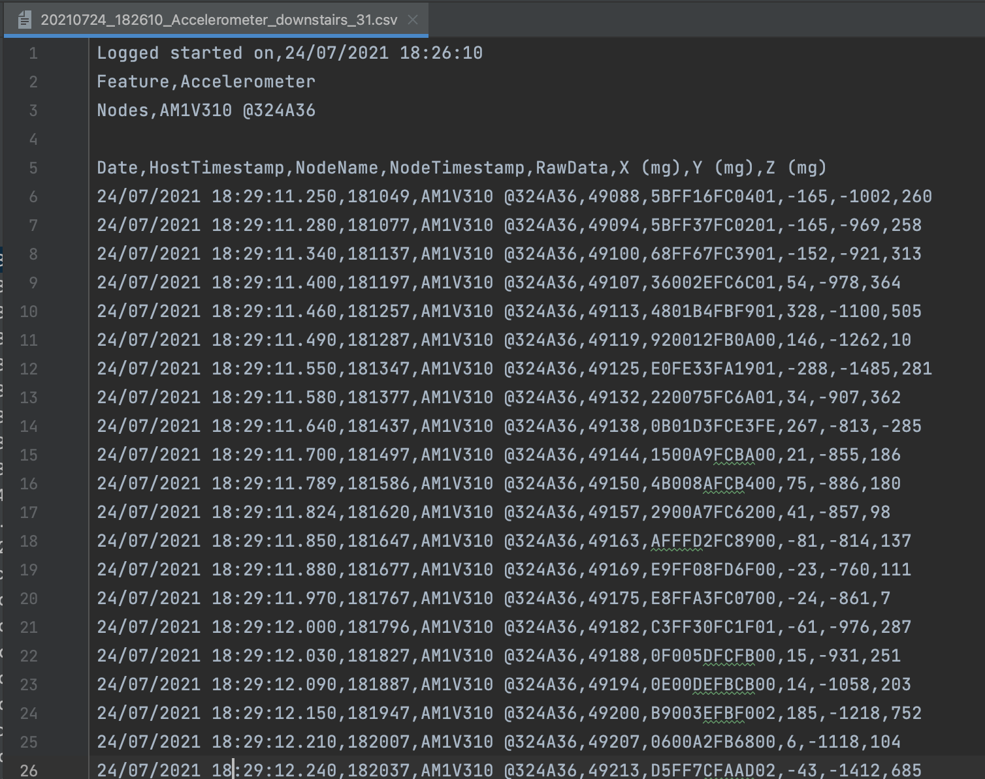
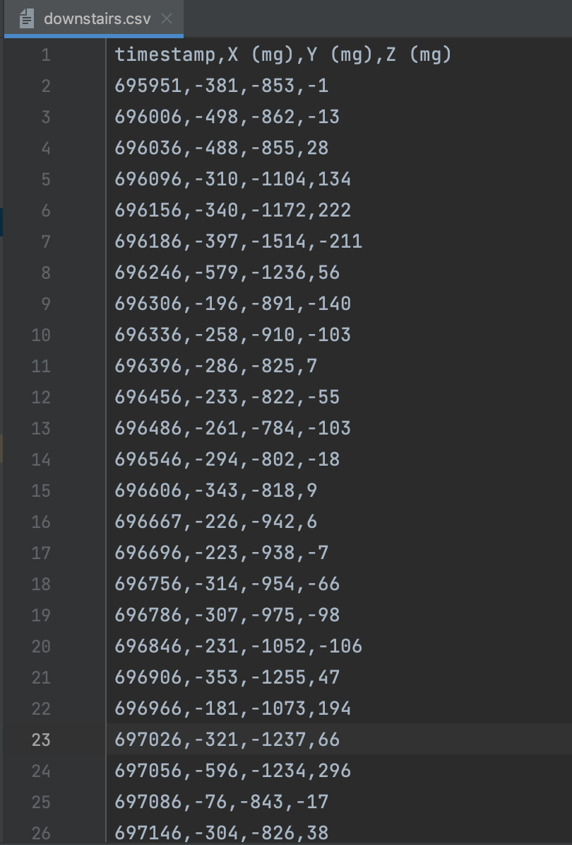
Accelerometer Data from SensorTile
RAW Data
Processed Data

Slide 7


Different Methods used to Analyze the data

Slide 8
Modelling using Python

Slide 9
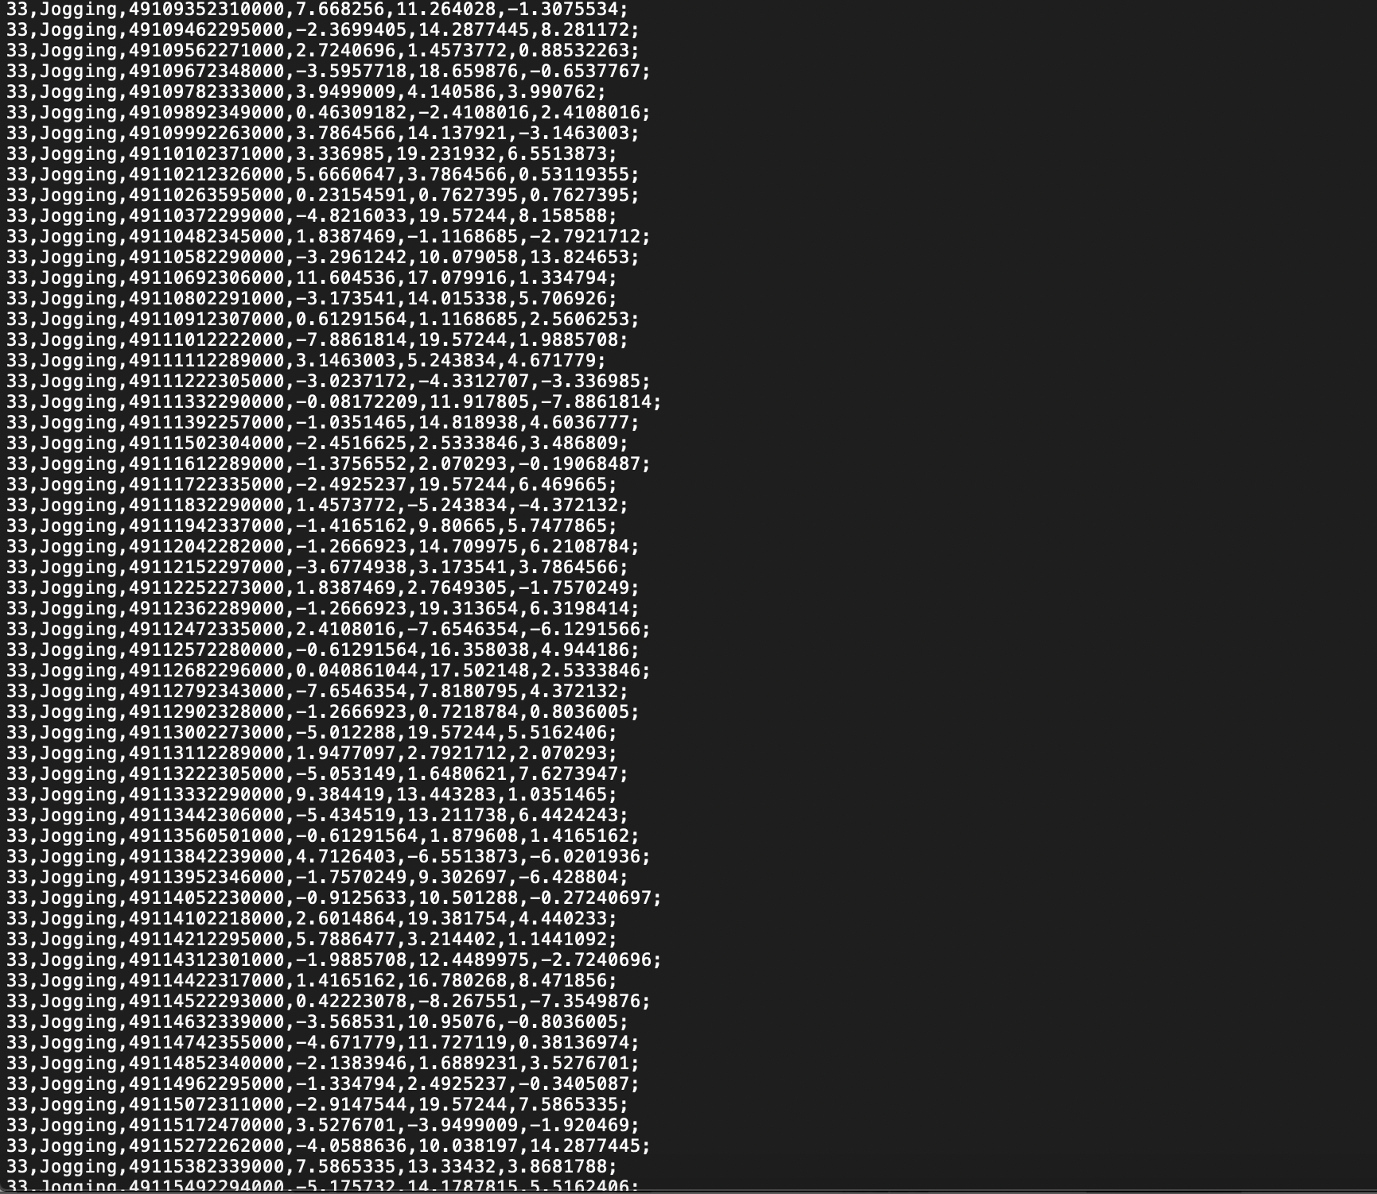
WISDM DataSet
Raw Time Series data has 1,098,207 examples, with six attributes.
Transformed examples data has 5,424 transformed examples and 46 transformed attributes.
WISDM Dataset as our Training Data for each of our models.
6 LABELS:
Sitting
Standing
Walking
Jogging
Upstairs
Downstairs
WISM_arv1.1_raw.txt

Slide 10
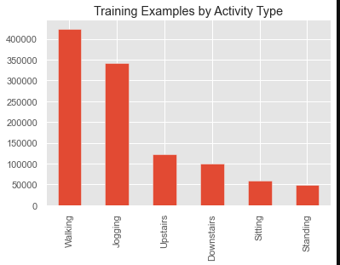
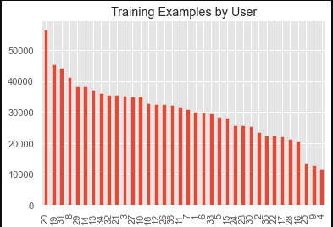
Exploratory Data Analysis

Slide 11
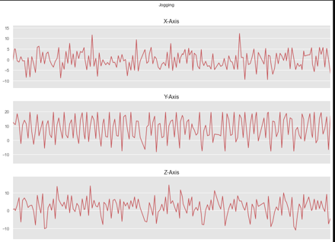
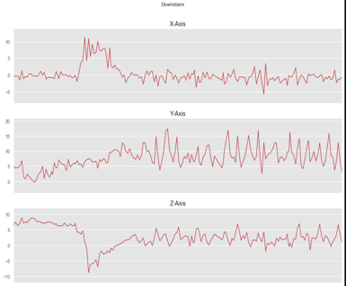
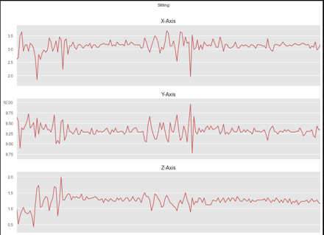
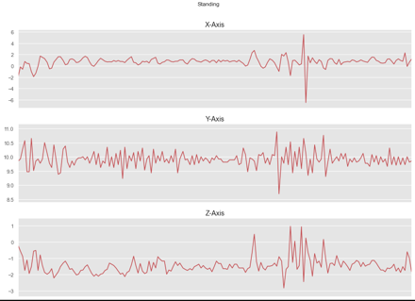
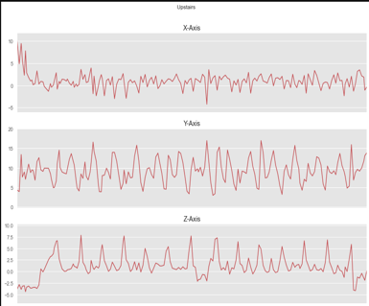
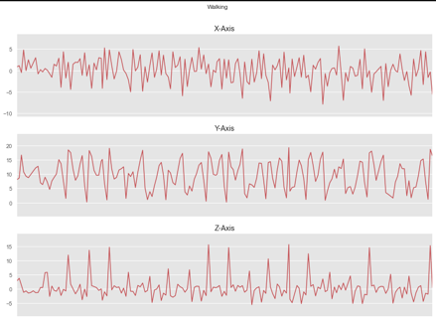
Visualization of Activities in X, Y and Z

Slide 12
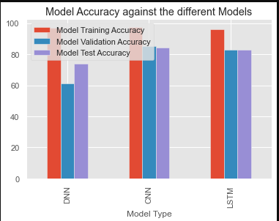
Model Accuracy
Models | Training Accuracy | Validation Accuracy | Test Accuracy
Deep Neural Network | 96.9% | 61.3% | 73.8%
Convolutional Neural Network | 97.6% | 85.1% | 84.5%
Long Short-Term Memory | 96.3% | 82.8% | 82.8%

Slide 13
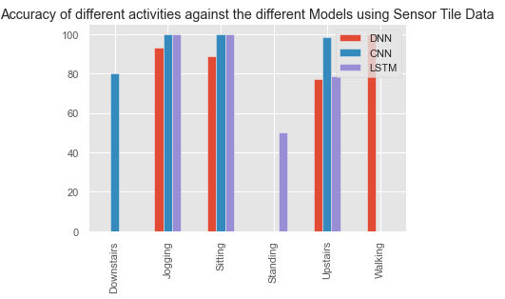
Model Accuracy using Sensor Tile Data

Slide 14

Modelling using Python

Slide 15
Modelling using EdgeImpulse

Slide 16

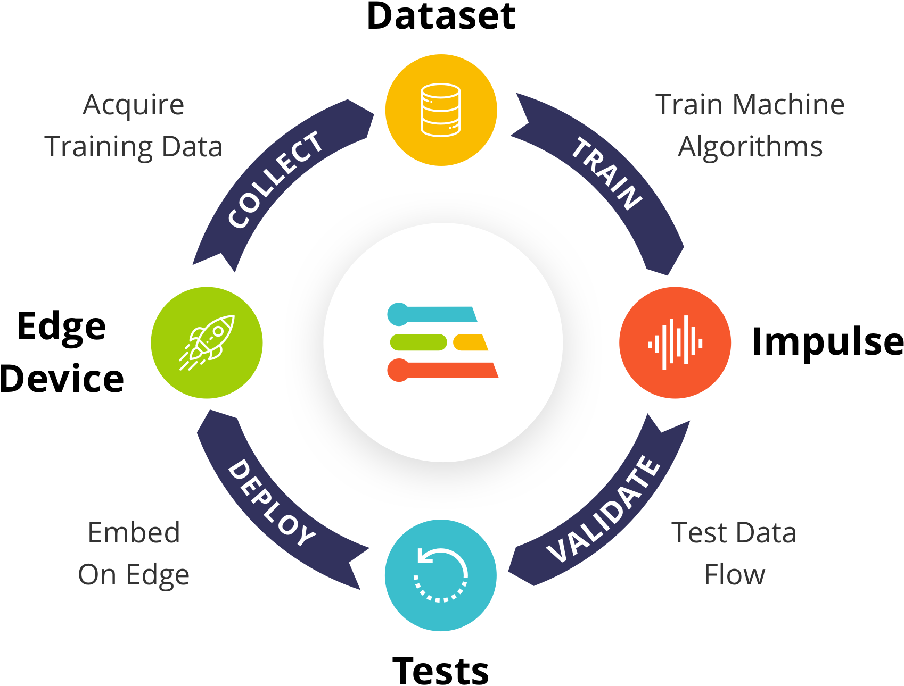

Slide 17
Modelling using EdgeImpulse

Slide 18
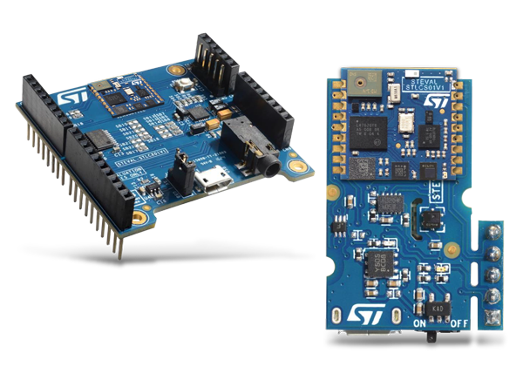

Resources
Hardware
Software
Data Collection:
SensorTile
Micro USB Cable
Power Bank
Communication and Sharing:
SmartPhone
Building Models:
Laptop
Data Collection:
STBLE App
Communication and Sharing:
Gmail
GitHub
Google Docs
Building Models:
Jupyter Notebook
EdgeImpulse

Slide 19
References
References in GitHub HAR Project Proposal
Human Activity Project Document HAR Project Presentation Human Activity Recognition Using WISDM dataset Jupyter Notebook
WISDM dataset
Parse Sensor Tile Data
Reference Materials
Human Activity Recognition Tutorial with Keras
Kaggle
HAR Time Series Classification
Load and Explore a standard HAR problem

Slide 20


Slide 21

- Lakshmi
- Srinivas
- Shreya

